Slide 1




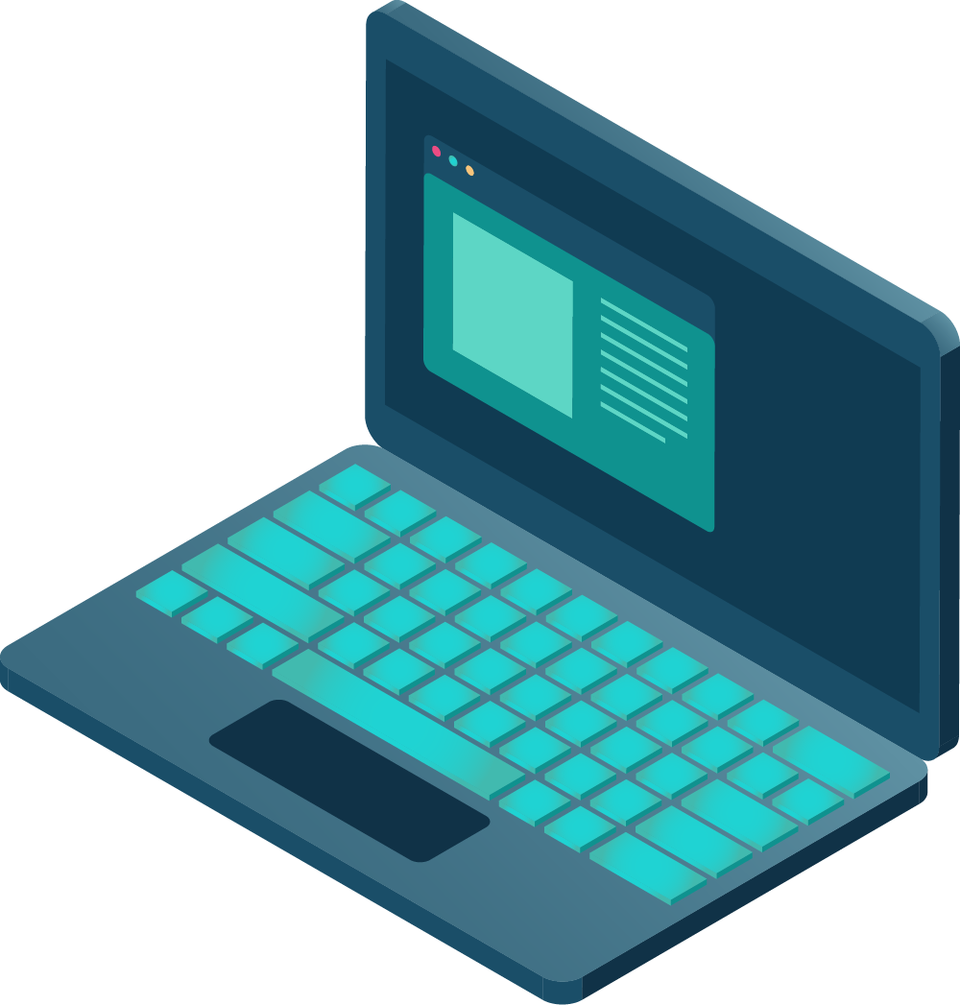
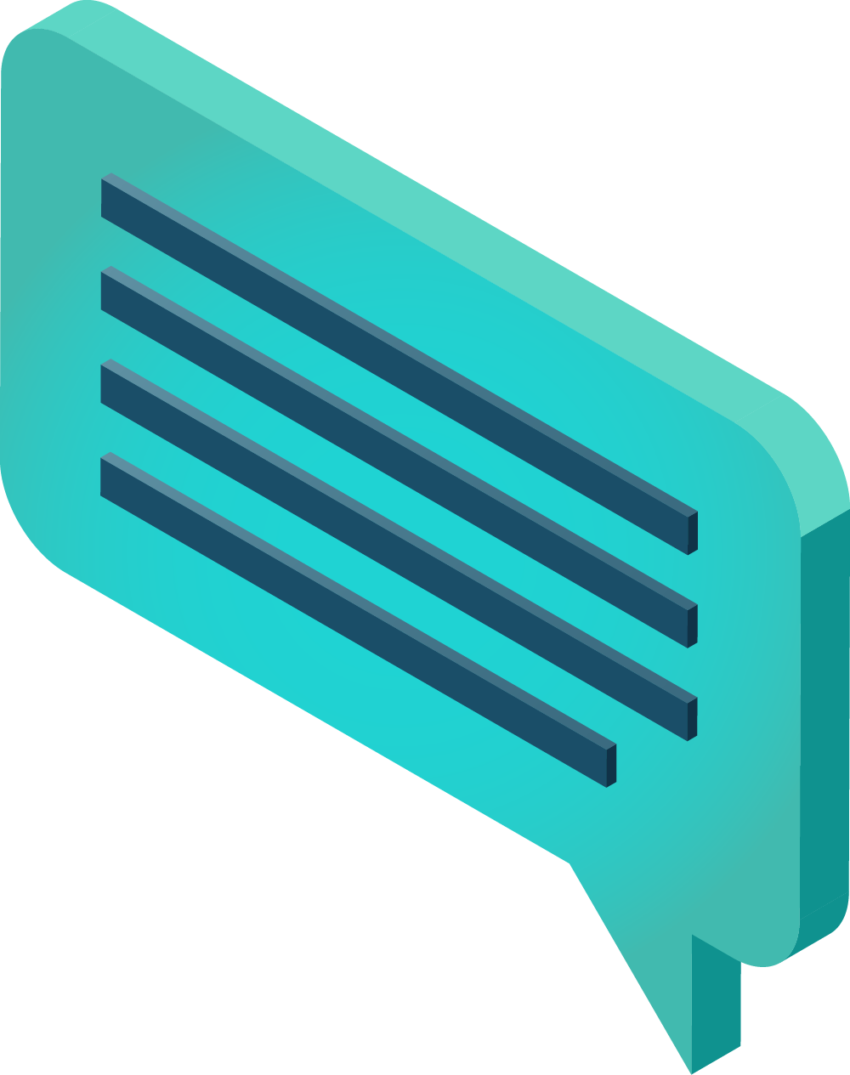
CYBER SECURITY KILL CHAIN
Here is where your presentation begins

Slide 2
CONTENTS OF THIS TEMPLATE
You can delete this slide when you’re done editing the presentation
Fonts | To view this template correctly in PowerPoint, download and install the fonts we used
Used and alternative resources | An assortment of graphic resources that are suitable for use in this presentation
Thanks slide | You must keep it so that proper credits for our design are given
Colors | All the colors used in this presentation
Icons and infographic resources | These can be used in the template, and their size and color can be edited
Editable presentation theme | You can edit the master slides easily. For more info, click here
For more info: Slidesgo | Blog | FAQs
You can visit our sister projects: Freepik | Flaticon | Storyset | Wepik | Videvo

Slide 3
TABLE OF CONTENTS
ABOUT
FRAMEWORK
01
02
HOW TO STOP
CONCLUSION
03
04
You can describe the topic of the section here
You can describe the topic of the section here
You can describe the topic of the section here
You can describe the topic of the section here

Slide 4
WHOA!
This can be the part of the presentation where you introduce yourself, write your email…

Slide 5
INTRODUCTION
You can give a brief description of the topic you want to talk about here. For example, if you want to talk about Mercury, you can say that it’s the smallest planet in the entire Solar System

Slide 6
ABOUT
01
You can enter a subtitle here if you need it

Slide 7

THE SLIDE TITLE GOES HERE!
Do you know what helps you make your point clear?
Lists like this one:
They’re simple
You can organize your ideas clearly
You’ll never forget to buy milk!
And the most important thing: the audience won’t miss the point of your presentation

Slide 8
MORE ABOUT THE TOPIC
Mercury is the closest planet to the Sun and the smallest one in the entire Solar System. This planet's name has nothing to do with the liquid metal, since Mercury was named after the Roman messenger god. Despite being closer to the Sun than Venus, its temperatures aren't as terribly hot as that planet's. Its surface is quite similar to that of Earth's Moon, which means there are a lot of craters and plains
Speaking of craters, many of them were named after artists or authors who made significant contributions to their respective fields. Mercury takes a little more than 58 days to complete its rotation, so try to imagine how long days must be there! Since the temperatures are so extreme, albeit not as extreme as in Venus, and the solar radiation is so high, Mercury has been deemed to be non-habitable for humans

Slide 9
SECURITY CONTROL
MERCURY
VENUS
Mercury is the closest planet to the Sun and the smallest one in the Solar System—it’s only a bit larger than the Moon
Venus has a beautiful name and is the second planet from the Sun. It’s hot and has a poisonous atmosphere

Slide 10
ATTACK STAGES
MERCURY
VENUS
MARS
It’s the closest planet to the Sun and the smallest in the Solar System
Venus has a very beautiful name and is the second planet from the Sun
Despite being red, Mars is actually a cold place. It’s full of iron oxide dust

Slide 11
CYBER ATTACK STAGES
VENUS
01
MARS
02
NEPTUNE
03
SATURN
04
Venus is the second planet from the Sun
Despite being red, Mars is a cold place
It’s the farthest planet from the Sun
It is a gas giant and has several rings

Slide 12
BREAKING THE CHAIN
MERCURY
VENUS
MARS
JUPITER
SATURN
NEPTUNE
It’s the closest planet to the Sun
Venus is the second planet from the Sun
Mars is actually a very cold place
Jupiter is the biggest planet of them all
It’s composed of hydrogen and helium
It’s the farthest planet from the Sun

Slide 13
TASKS
TASK | TO DO | DOING | DONE
Mercury the closest planet to the Sun
Venus has a beautiful name but it’s very hot
Jupiter is the biggest planet in the Solar System

Slide 14
AWESOME WORDS

Slide 15
— SOMEONE FAMOUS
“This is a quote. Words full of wisdom that someone important said and can make the reader get inspired”

Slide 16
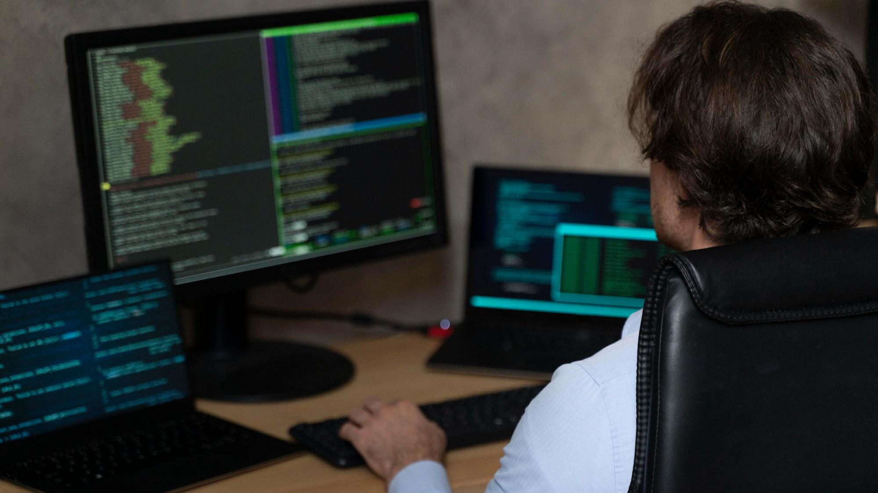
A PICTURE IS WORTH A THOUSAND WORDS

Slide 17
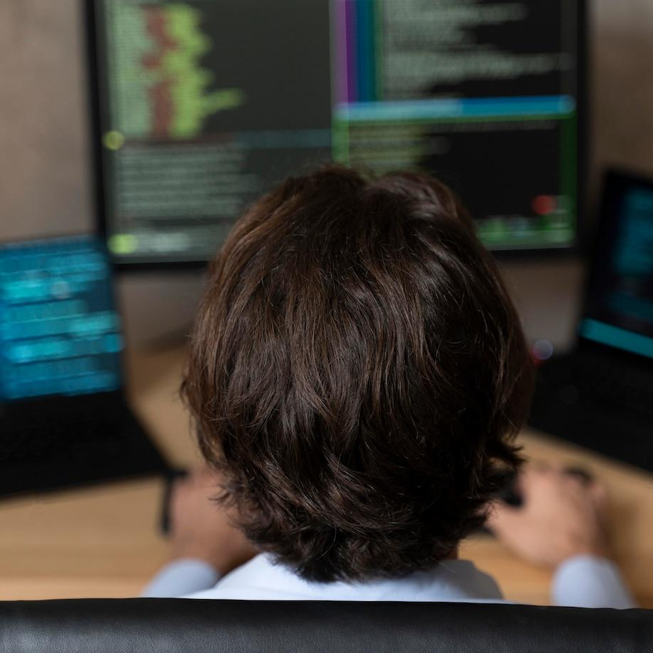
A PICTURE ALWAYS REINFORCES THE CONCEPT
Images reveal large amounts of data, so remember: use an image instead of a long text. Your audience will appreciate it

Slide 18
02
SECURITY CONTROL
You can enter a subtitle here if you need it

Slide 19
10,520,000
Big numbers catch your audience’s attention

Slide 20
723
320
125
Mercury is the closest planet to the Sun
Venus is the second planet from the Sun
Mars is actually a very cold place to live on

Slide 21
SURVEY RESULTS
25%
50%
75%
MERCURY
VENUS
MARS
It’s the closest planet to the Sun
Venus is the second planet from the Sun
Mars is actually a very cold place

Slide 22
QUESTION AND ANSWER
MERCURY
VENUS
Mercury is the closest planet to the Sun and also the smallest one in the entire Solar System
Venus has a beautiful name and is the second planet from the Sun. It’s hot and has a poisonous atmosphere

Slide 23
SCHEDULE
SU | M | T | W | TH | F | S
30 | 1 | 2 | 3 | 4 | 5 | 6
7 | 8 | 9 | 10 | 11 | 12 | 13
14 | 15 | 16 | 17 | 18 | 19 | 20
21 | 22 | 23 | 24 | 25 | 26 | 27
28 | 29 | 30 | 31 | 1 | 2 | 3
VENUS
Venus has a beautiful name and it’s very hot
MARS
Despite being red, Mars is a cold place

Slide 24
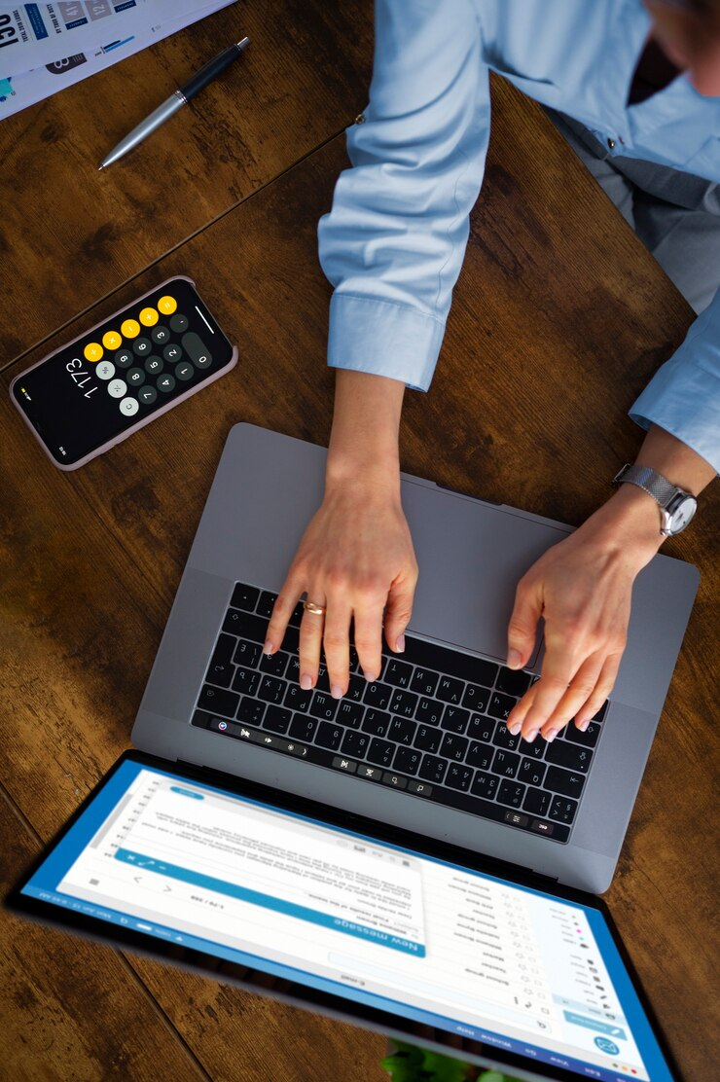
TABLET SCREENSHOT
You can replace the image on the screen with your own work. Just right-click on it and select “Replace image”

Slide 25
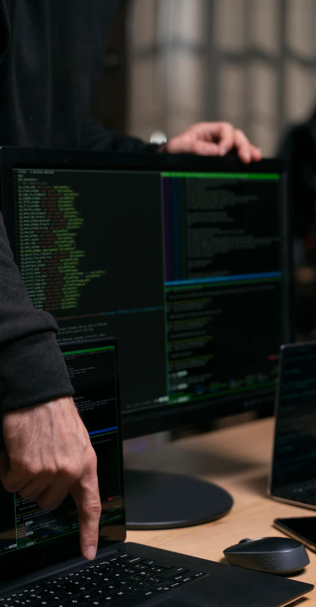
MOBILE SCREENSHOT
You can replace the image on the screen with your own work. Just right-click on it and select “Replace image”

Slide 26
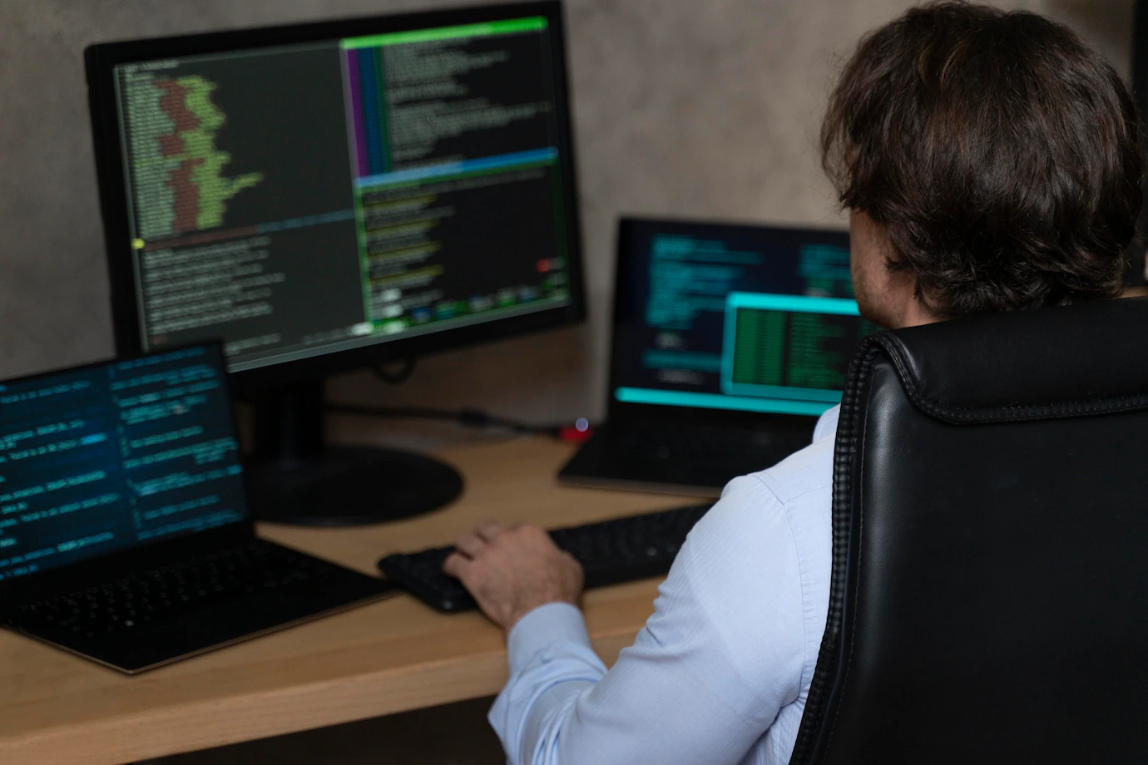
DESKTOP SCREENSHOT
You can replace the image on the screen with your own work. Just right-click on it and select “Replace image”

Slide 27
WORLDWIDE TEAM
Mercury
Mercury is the closest planet to the Sun and the smallest planet in the Solar System

Slide 28
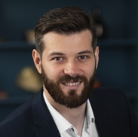
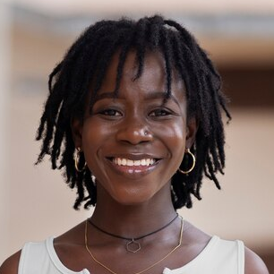
MEET THE TEAM
TIMMY JIMMY
SUSAN BONES
You can speak a bit about this person here
You can speak a bit about this person here

Slide 29
TIMELINE
2XXX
2XXX
2XXX
2XXX
Mars
Mercury
Saturn
Venus
Even if it’s red, Mars is a cold place to live on
Mercury is the closest planet to the Sun
Saturn is the ringed one and a gas giant
Venus has a beautiful name, but terribly hot

Slide 30
HOW TO SECURE YOUR DATA
MARS
SATURN
It is red, but it’s a very cold place
Saturn is actually a gas giant
MERCURY
VENUS
It is the closest planet to the Sun
It has a beautiful name, but hot

Slide 31
SECURITY CONTROL
MARS | VENUS | MERCURY | JUPITER
Small Red Cold Rocky | Small Hot Dry Vulcanic | Small Hot Rocky Cratered | Large Cold Grassy Stripped
Mars is actually a very cold place | It’s the second planet from sun | Mercury is the smallest planet of them all | Jupiter is the biggest planet in the our System

Slide 32
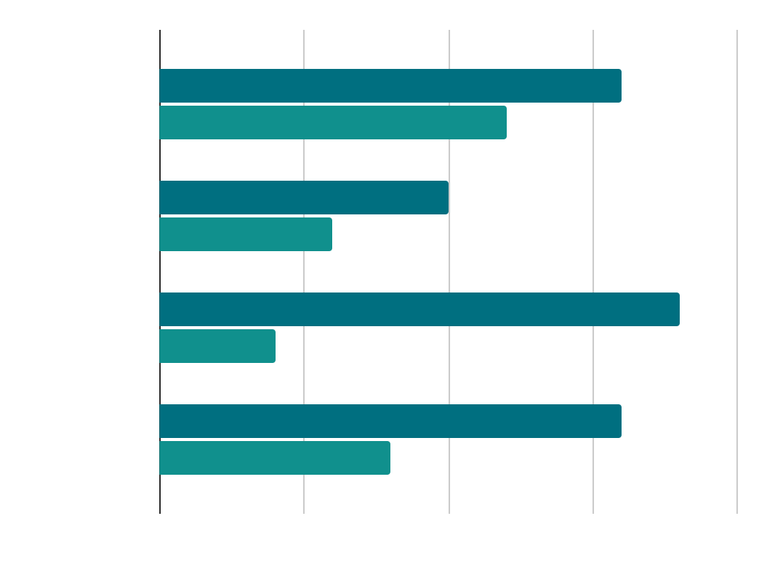
DYNAMIC DATA EXCHANGE
SATURN
Saturn is the ringed one and a gas giant
VENUS
Venus in fact has a very beautiful name
Follow the link in the graph to modify its data and then paste the new one here. For more info, click here

Slide 33
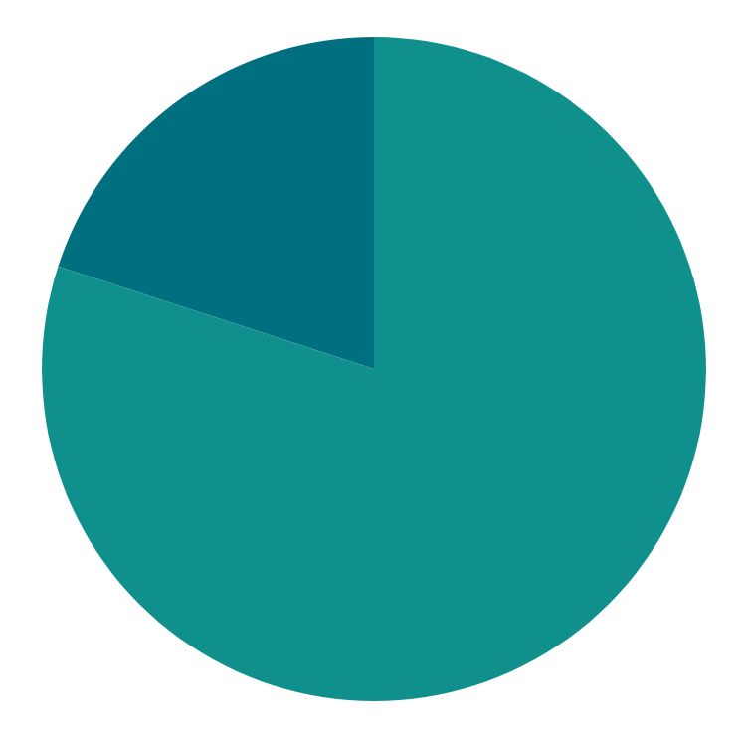
POWERSHELL POTENCY
20%
SATURN
Saturn is the ringed one and a gas giant
80%
VENUS
Venus in fact has a very beautiful name
Follow the link in the graph to modify its data and then paste the new one here. For more info, click here

Slide 34
COMPARISONS
25%
50%
MERCURY
VENUS
Mercury is the smallest one in the Solar System but larger than Moon
It has a beautiful name and the second closest planet from the Sun

Slide 35
THANK YOU!
Does anyone have any questions?
youremail@freepik.com
+91 620 421 838
yourcompany.com
CREDITS: This presentation template was created by Slidesgo, including icons by Flaticon, and infographics & images by Freepik
Please keep this slide for attribution

Slide 36

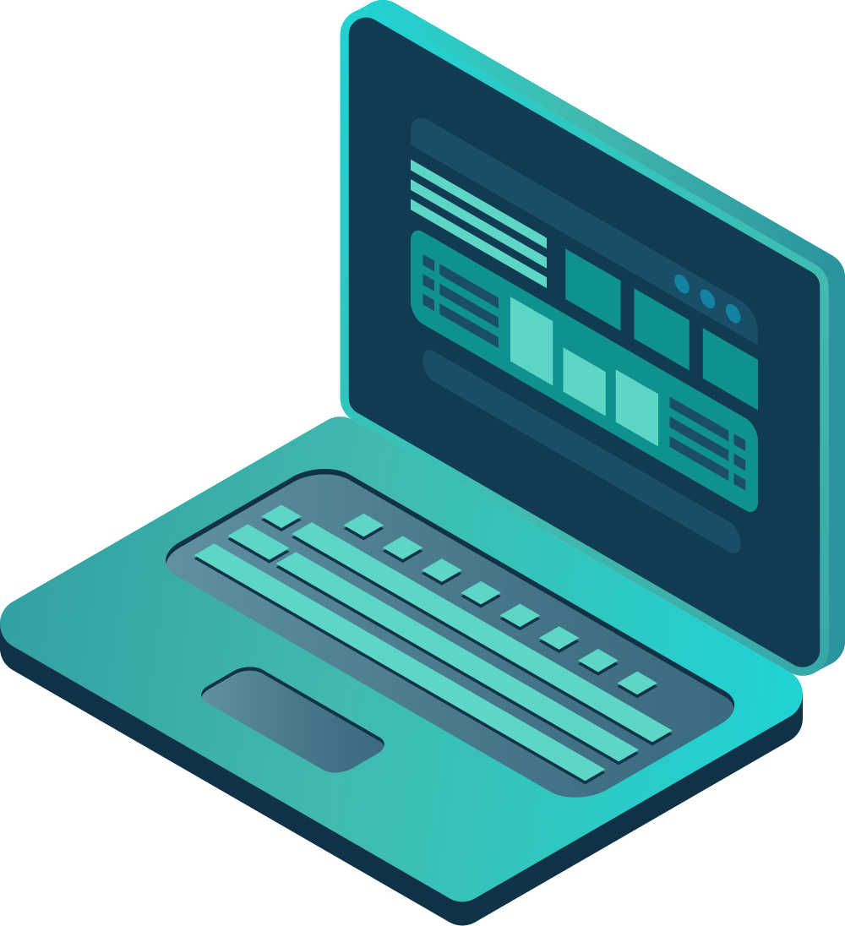

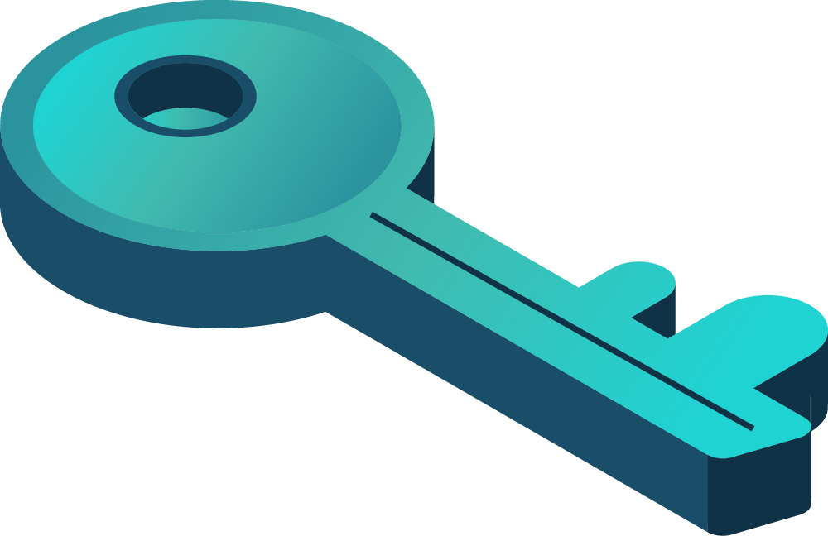
Alternative resources
Here’s an assortment of alternative resources whose style fits the one of this template:
VECTORS:
Data protection landing page

Slide 37
Resources
Did you like the resources on this template? Get them for free at our other websites:
PHOTOS:
Close up programmer typing on keyboard
Close up programmer sitting at desk
Above view woman typing on laptop
Cyber security concept with computer close up
Close up programmer typing on keyboard
Portrait of young woman with afro dreadlocks posing outside
Medium shot smiley man sitting at desk
VECTORS:
Cyber security instagram stories template

Slide 38
Instructions for use
If you have a free account, in order to use this template, you must credit Slidesgo by keeping the Thanks slide. Please refer to the next slide to read the instructions for premium users.
As a Free user, you are allowed to:
Modify this template.
Use it for both personal and commercial projects.
You are not allowed to:
Sublicense, sell or rent any of Slidesgo Content (or a modified version of Slidesgo Content).
Distribute Slidesgo Content unless it has been expressly authorized by Slidesgo.
Include Slidesgo Content in an online or offline database or file.
Offer Slidesgo templates (or modified versions of Slidesgo templates) for download.
Acquire the copyright of Slidesgo Content.
For more information about editing slides, please read our FAQs or visit our blog:
https://slidesgo.com/faqs and https://slidesgo.com/slidesgo-school

Slide 39
Instructions for use (premium users)
As a Premium user, you can use this template without attributing Slidesgo or keeping the "Thanks" slide.
You are allowed to:
Modify this template.
Use it for both personal and commercial purposes.
Hide or delete the “Thanks” slide and the mention to Slidesgo in the credits.
Share this template in an editable format with people who are not part of your team.
You are not allowed to:
Sublicense, sell or rent this Slidesgo Template (or a modified version of this Slidesgo Template).
Distribute this Slidesgo Template (or a modified version of this Slidesgo Template) or include it in a database or in any other product or service that offers downloadable images, icons or presentations that may be subject to distribution or resale.
Use any of the elements that are part of this Slidesgo Template in an isolated and separated way from this Template.
Register any of the elements that are part of this template as a trademark or logo, or register it as a work in an intellectual property registry or similar.
For more information about editing slides, please read our FAQs or visit our blog:
https://slidesgo.com/faqs and https://slidesgo.com/slidesgo-school

Slide 40
Fonts & colors used
This presentation has been made using the following fonts:
Alumni Sans Pinstripe
(https://fonts.google.com/specimen/Alumni+Sans+Pinstripe)
Roboto Slab
(https://fonts.google.com/specimen/Advent+Pro)
#ffffff
#00394b
#002530
#006f80
#10908d

Slide 41



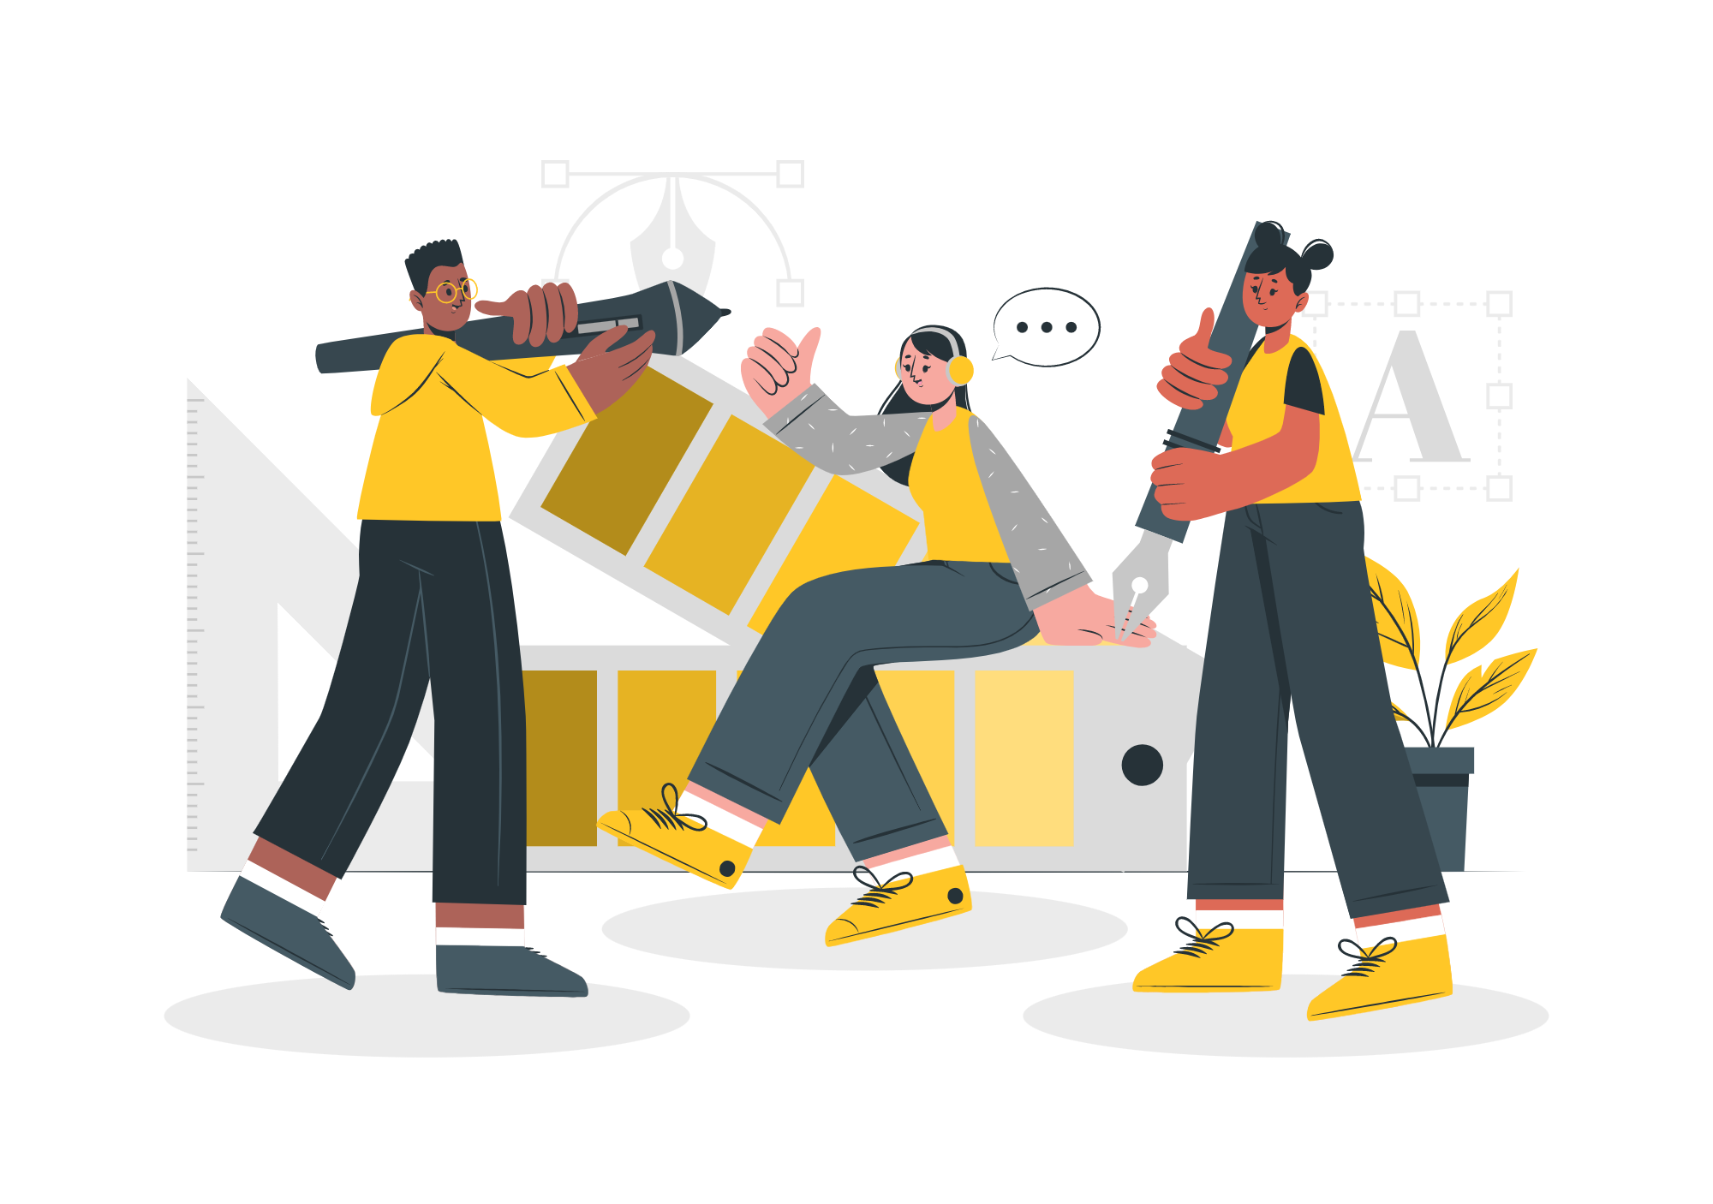

Storyset
Create your Story with our illustrated concepts. Choose the style you like the most, edit its colors, pick the background and layers you want to show and bring them to life with the animator panel! It will boost your presentation. Check out how it works.
Pana
Amico
Bro
Rafiki
Cuate

Slide 42
Use our editable graphic resources...
You can easily resize these resources without losing quality. To change the color, just ungroup the resource and click on the object you want to change. Then, click on the paint bucket and select the color you want. Group the resource again when you’re done. You can also look for more infographics on Slidesgo.

Slide 45
JANUARY
FEBRUARY
MARCH
APRIL
MAY
JUNE
PHASE 1
Task 1
Task 2
PHASE 2
Task 1
Task 2
JANUARY
FEBRUARY
MARCH
APRIL
PHASE 1
Task 1
Task 2

Slide 48
...and our sets of editable icons
You can resize these icons without losing quality.
You can change the stroke and fill color; just select the icon and click on the paint bucket/pen.
In Google Slides, you can also use Flaticon’s extension, allowing you to customize and add even more icons.

Slide 49
Educational Icons
Medical Icons

Slide 50
Business Icons
Teamwork Icons

Slide 51
Help & Support Icons
Avatar Icons

Slide 52
Creative Process Icons
Performing Arts Icons

Slide 53
Nature Icons

Slide 54
SEO & Marketing Icons

Slide 55


